Slide 1

DEPARTMENT OF
ARTIFICIAL INTELLIGENCE AND DATA SCIENCE
ACADEMIC YEAR 2025 - 2026
SEMESTER III
ARTIFICIAL INTELLIGENCE LABORATORY
MINI PROJECT REVIEW
STUDENT PERFORMANCE PREDICTION
REGISTER NUMBER | 2117240070185
NAME | MITHUNKUMAR KT
YEAR | II
SECTION | C
FACULTY IN-CHARGE | Ms . Phebe Persis

Slide 2
PROBLEM STATEMENT
.
Brief Overview of Artificial Intelligence Concepts
Artificial Intelligence (AI) is a field of computer science that focuses on developing systems capable of performing tasks that normally require human intelligence, such as learning, reasoning, and decision-making. One of the major applications of AI is in predictive analytics, where machines learn patterns from data to forecast future outcomes.
In this project, AI techniques are applied to predict student performance using machine learning algorithms. The model analyzes key academic factors like study hours, attendance, assignments, and sleep hours to estimate the expected marks of a student. This approach demonstrates how AI can support educational institutions in identifying performance trends and improving academic outcomes.
Why the Problem Matters
Teachers and educators identify students who need additional academic support.
Institutions improve learning outcomes through data-driven decisions.
Parents track and understand their child’s academic progress effectively
Students receive personalized study recommendations to enhance performance.
Project Aim
The main goal of this project is to develop a machine learning-based prediction model using Linear Regression to estimate student performance.The model predicts the expected marks of a student based on measurable academic parameters such as study hours, attendance percentage, assignments completed, and sleep duration.

Slide 3
THEORETICAL BACKGROUND
.
Theoretical Background of the Problem and Algorithm
  In this project, a Linear Regression model — one of the simplest and most interpretable supervised learning algorithms — is used to predict student marks based on academic and behavioral factors.
  The model establishes a linear relationship between input variables (such as study hours, attendance, assignments, and sleep hours) and the target variable (marks).
  By learning the coefficients for each factor, the model generates a prediction equation that estimates the expected performance of a student.
Literature Survey
Researchers have applied Linear Regression and other supervised learning models to predict student academic performance based on attendance, study hours, and prior grades.
Studies indicate that machine learning algorithms outperform traditional statistical methods in accurately forecasting student success and identifying at-risk learners.
Hybrid approaches combining Regression and Classification models have been used to improve prediction accuracy and interpretability in educational analytics.
Recent research highlights the use of AI-driven systems for personalized learning, performance tracking, and academic decision-making in schools and universities.
Justification for Choosing the Algorithm
The algorithm is simple, interpretable, and easy to implement, making it suitable for educational data analysis.
It provides a quantitative understanding of how each input variable (like study hours or attendance) impacts the final marks.
The model performs well even with limited datasets, producing accurate and consistent predictions.
It serves as a strong baseline algorithm for future enhancements using advanced AI models.
It effectively models the relationship between multiple academic factors and student performance

Slide 4
EXPLANATION OF ALGORITHM
Bayes’ Theorem:
Where:
  • Y – Predicted Marks of the Student
  • b₀ – Intercept or constant term
  • b₁, b₂, b₃, b₄ – Coefficients that represent the weight of each input factor
  • X₁ – Study Hours
  • X₂ – Attendance Percentage
  • X₃ – Assignments Completed
  • X₄ – Sleep Hours

Slide 5
IMPLEMENTATION AND CODE
Link to code in Git-hub Repository
List | Git-hub Repository Links
Implementation of Code Link | https://github.com/mithunkumar2006/AI-mini-Project
Word Document Report Link | https://github.com/mithunkumar2006/AI-mini-Project
PPT Link | https://github.com/mithunkumar2006/AI-mini-Project

Slide 6
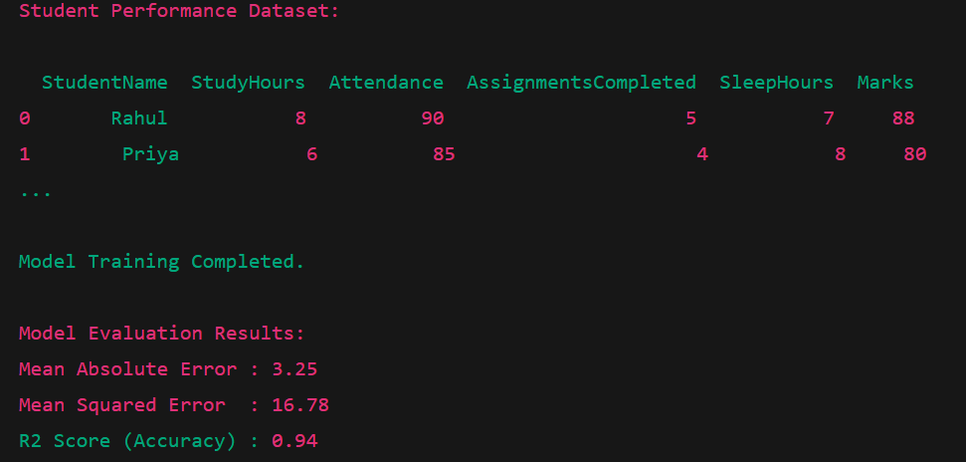
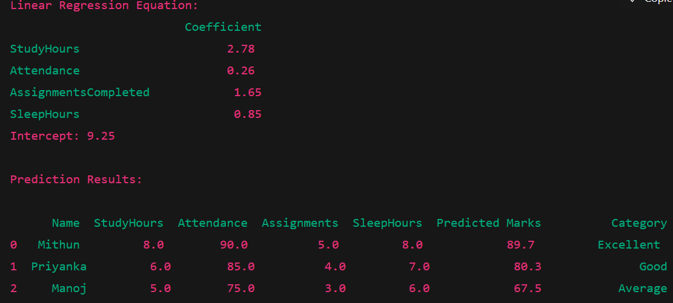
OUTPUT AND RESULTS

Slide 7
REFERENCES
Russell, S., & Norvig, P. (2021). Artificial Intelligence: A Modern Approach (4th ed.). Pearson Education.
Géron, A. (2019). Hands-On Machine Learning with Scikit-Learn, Keras, and TensorFlow. O’Reilly Media.
Han, J., Kamber, M., & Pei, J. (2011). Data Mining: Concepts and Techniques (3rd ed.). Morgan Kaufmann Publishers.
"Scikit-Learn User Guide" – Machine Learning in Python, https://scikit-learn.org
Witten, I. H., Frank, E., Hall, M. A., & Pal, C. J. (2016). Data Mining: Practical Machine Learning Tools and Techniques (4th ed.). Morgan Kaufmann.

